Slide 1
Developing a Transport-Related Social Exclusion Index for Canada Maria Laura Guerrero Balarezo Polytechnique Montréal-CIRRELT Genevieve Boisjoly Polytechnique Montréal-CIRRELT Martin Trépanier Polytechnique Montréal-CIRRELT

Slide 2
Background

Slide 3
Previous Work
Sizing up transport poverty: A national scale accounting of low-income households suffering from inaccessibility in Canada, and what to do about it (Allen, Farber 2019)
Methodology
Accessibility to job opportunities by public transport
Metropolitan Areas
Typology of transport poor neighbourhoods: k-means cluster analysis of zones at high or very high risk of transport poverty for policy recommendations
Variables: access to jobs by transit and car, population density, % of population living in apartments, number of residents in low-income households, % of residents living in new housing stock (built since 2000t), % who have moved recently
Conclusions
Substantial number of low-income Canadians living in areas of low transit accessibility
Transport policy in Canadian cities should focus towards improving transit service to low accessibility neighbourhoods
Access to employment as a proxy measure for the distribution of transit benefits across multiple regions, but no other measures of deprivation or vulnerability

Slide 4
Allen J., Farber S., (2019) Sizing up transport poverty: A national scale accounting of low-income households suffering from inaccessibility in Canada, and what to do about it, Transport Policy, 74, 214-223
Methodology
Accessibility to job opportunities by public transport
Metropolitan Areas
Typology of transport poor neighbourhoods: k-means cluster analysis of zones at high or very high risk of transport poverty for policy recommendations
Conclusions
Substantial number of low-income Canadians living in areas of low transit accessibility
Transport policy in Canadian cities should focus towards improving transit service to low accessibility neighbourhoods
Access to employment as a proxy measure for the distribution of transit benefits across multiple regions, but no other measures of deprivation or vulnerability
Previous Work

Slide 5
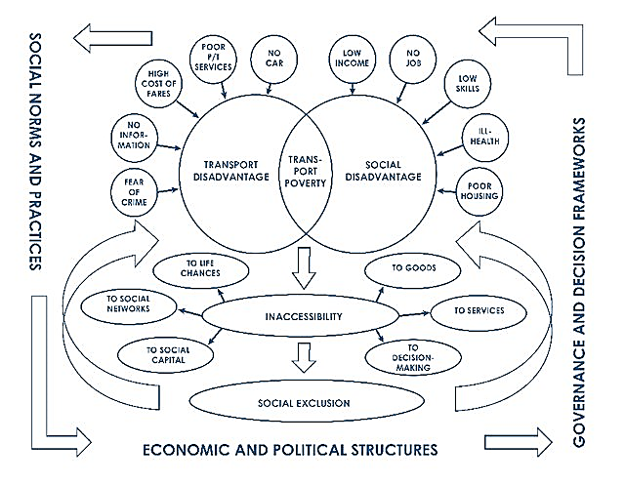
Transport Poverty
Lucas, K (2004). Transport and social exclusion: Where are we now?

Slide 6
Transport-Related social exclusion index
Socio-Economic Exclusion
Transport-Spatial Exclusion
CanMARG
Demand (Use)
Supply
Census Data
Dimensions
Households and dwellings
Material resources
Age and labour force
Immigration and visible minority
Census data
Commute mode
Commute time
Accessiblity
Public Transport
Walking

Slide 7
National Index
Socio-Economic Exclusion
CANMARG
Transport Spatial Exclusion
Transport-Related Social
Exclusion

Slide 8
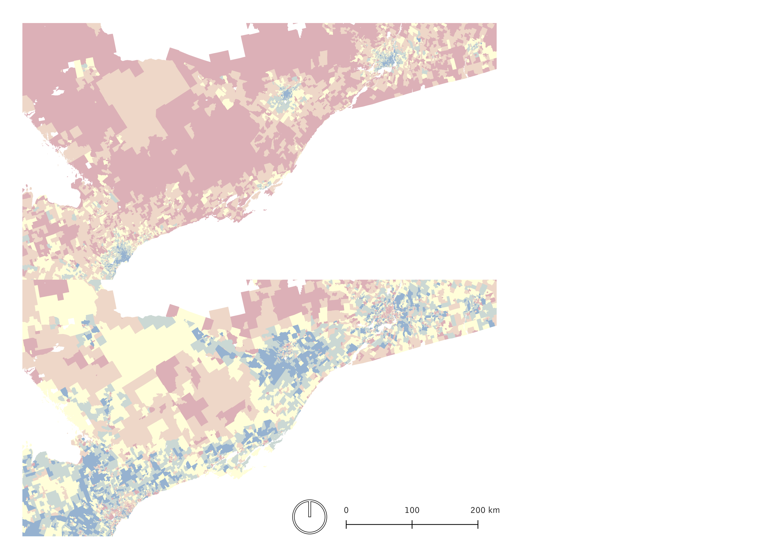
Ottawa
Montréal
50% Social Exclusion
50% Transport Exclusion
Toronto
Challenge 1: Weight Calibration

Slide 9
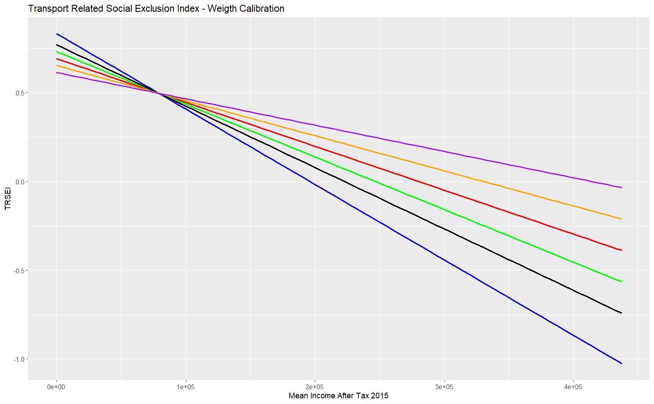
Challenge 1: Weight Calibration
70% Tr / 30% Soc
60% Tr / 40% Soc
50% Tr / 50% Soc
40% Tr / 60% Soc
30% Tr / 70% Soc
14% Tr / 68% Soc

Slide 10
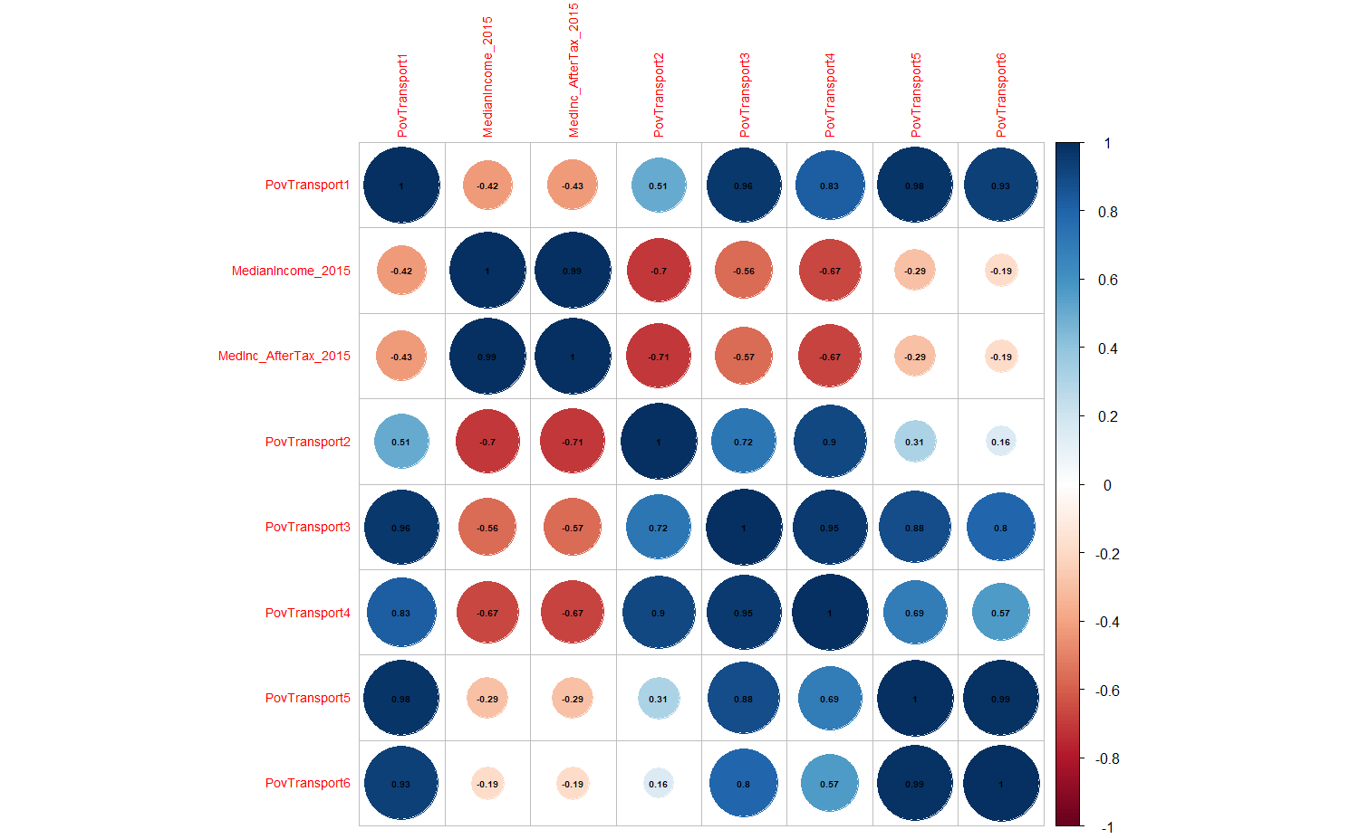
Challenge 1: Weight Calibration
50T/50% S
Median Income 2015
Median Income After Tax 2015
14T/68% S
30T/70% S
50T/50% S
40T/60% S
Median Income 2015
60T/40% S
Median Income After Tax 2015
70T/30% S
14T/68% S
30T/70% S
40T/60% S
60T/40% S
70T/30% S

Slide 11
Ottawa
Montréal
50% Social Exclusion
50% Transport Exclusion
Toronto
Challenge 1: Weight Calibration
Ottawa
Montréal
86% Social Exclusion
14% Transport Exclusion
Toronto

Slide 12
Challenge 2: Information Montreal Index
Social Exclusion
Transport Exclusion
Similarity

Slide 13
Challenge 2: Information Montreal Index
Social Exclusion
Transport-Related
Social Exclusion

Slide 14
Social Exclusion
Transport Exclusion
Challenge 2: Information Toronto Index
Similarity

Slide 15
Challenge 2: Information Toronto Index
Social Exclusion
Transport-Related
Social Exclusion

Slide 16
Social Exclusion
Transport Exclusion
Challenge 2: Information Calgary Index
Similarity

Slide 17
Challenge 2: Information Calgary Index
Social Exclusion
Transport-Related
Social Exclusion

Slide 18
Challenge 3: Scale of Representation
National Database
Provincial Database

Slide 19
Challenge 3: Scale of Representation
National Database
Provincial Database

