Slide 1
Visualizing Complex Origin-Destination Flows: A Network Backbone Approach
Jinpeng Wang, Yujie Hu
University of Florida

Slide 2
Origin-Destination(OD) Flows
Number of people moving between origins and destinations
Abstracted as a directed network
Origins and destinations as nodes
Flows as directed edges
Flow intensity as weight of edges
Complex OD flows need reduction to effectively visualize
Origin
Origin/Destination
Destination

Slide 3
Study Area and Data Used
State of Florida
Florida average daily commuters between census tracts between 2012 and 2016
Census Transportation Planning Products Program (CTPP)
American Community Survey(ACS)

Slide 4
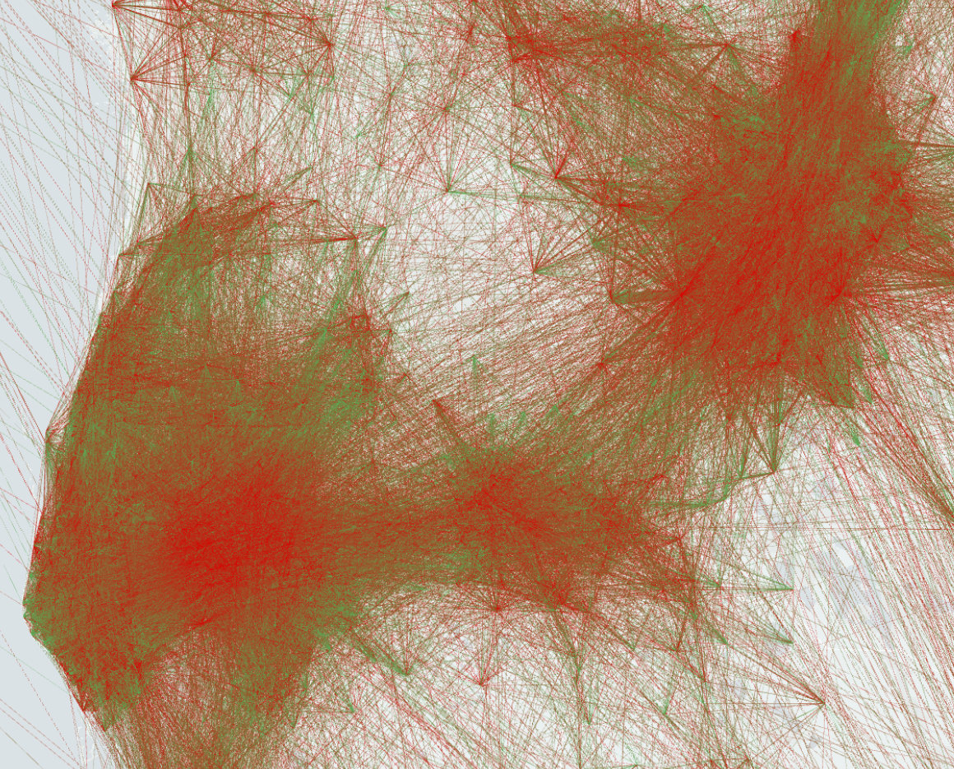
Florida Commuting Flow Network
212,315 flows (edges)
4,245 census tracts (nodes)
Green: Origin
Red: Destination
Width: Number of Commuters

Slide 5
Global Thresholding Reduction Method(GTB)
Setting a cutoff threshold of weight
Remove all the flows with a lower weight than the threshold
Remaining flows are backbones
Traditional method to be compared to
Too simple, small cities can barely have backbones

Slide 6
Disparity Filter Backbone Extraction Algorithm(DFB)
Introduced by network scientist Dr. Serrano
Probability parameter is given as:
$$α_{ij}=1−(k−1)\int_{0}^{p_{ij}}{{(1−x)}^{k−2}}dx$$
$p_{ij}=w_{ij}/s_{i}$
k: degree of node i
$s_{i}:$ Strength of node i
$p_{ij}=w_{ij}/s_{i}$ : normalized weight (local importance)

Slide 7
Method
Remove intra-census tract flows
Calculate the $α_{ij}$ for each edge
Filter the edges by their $α_{ij}$ value using a threshold $α$to get the DFB.
The smaller the threshold 𝛼, the stricter it gets
Setting a global threshold to get a similar number of remaining edges in the GTB as comparison.

Slide 8
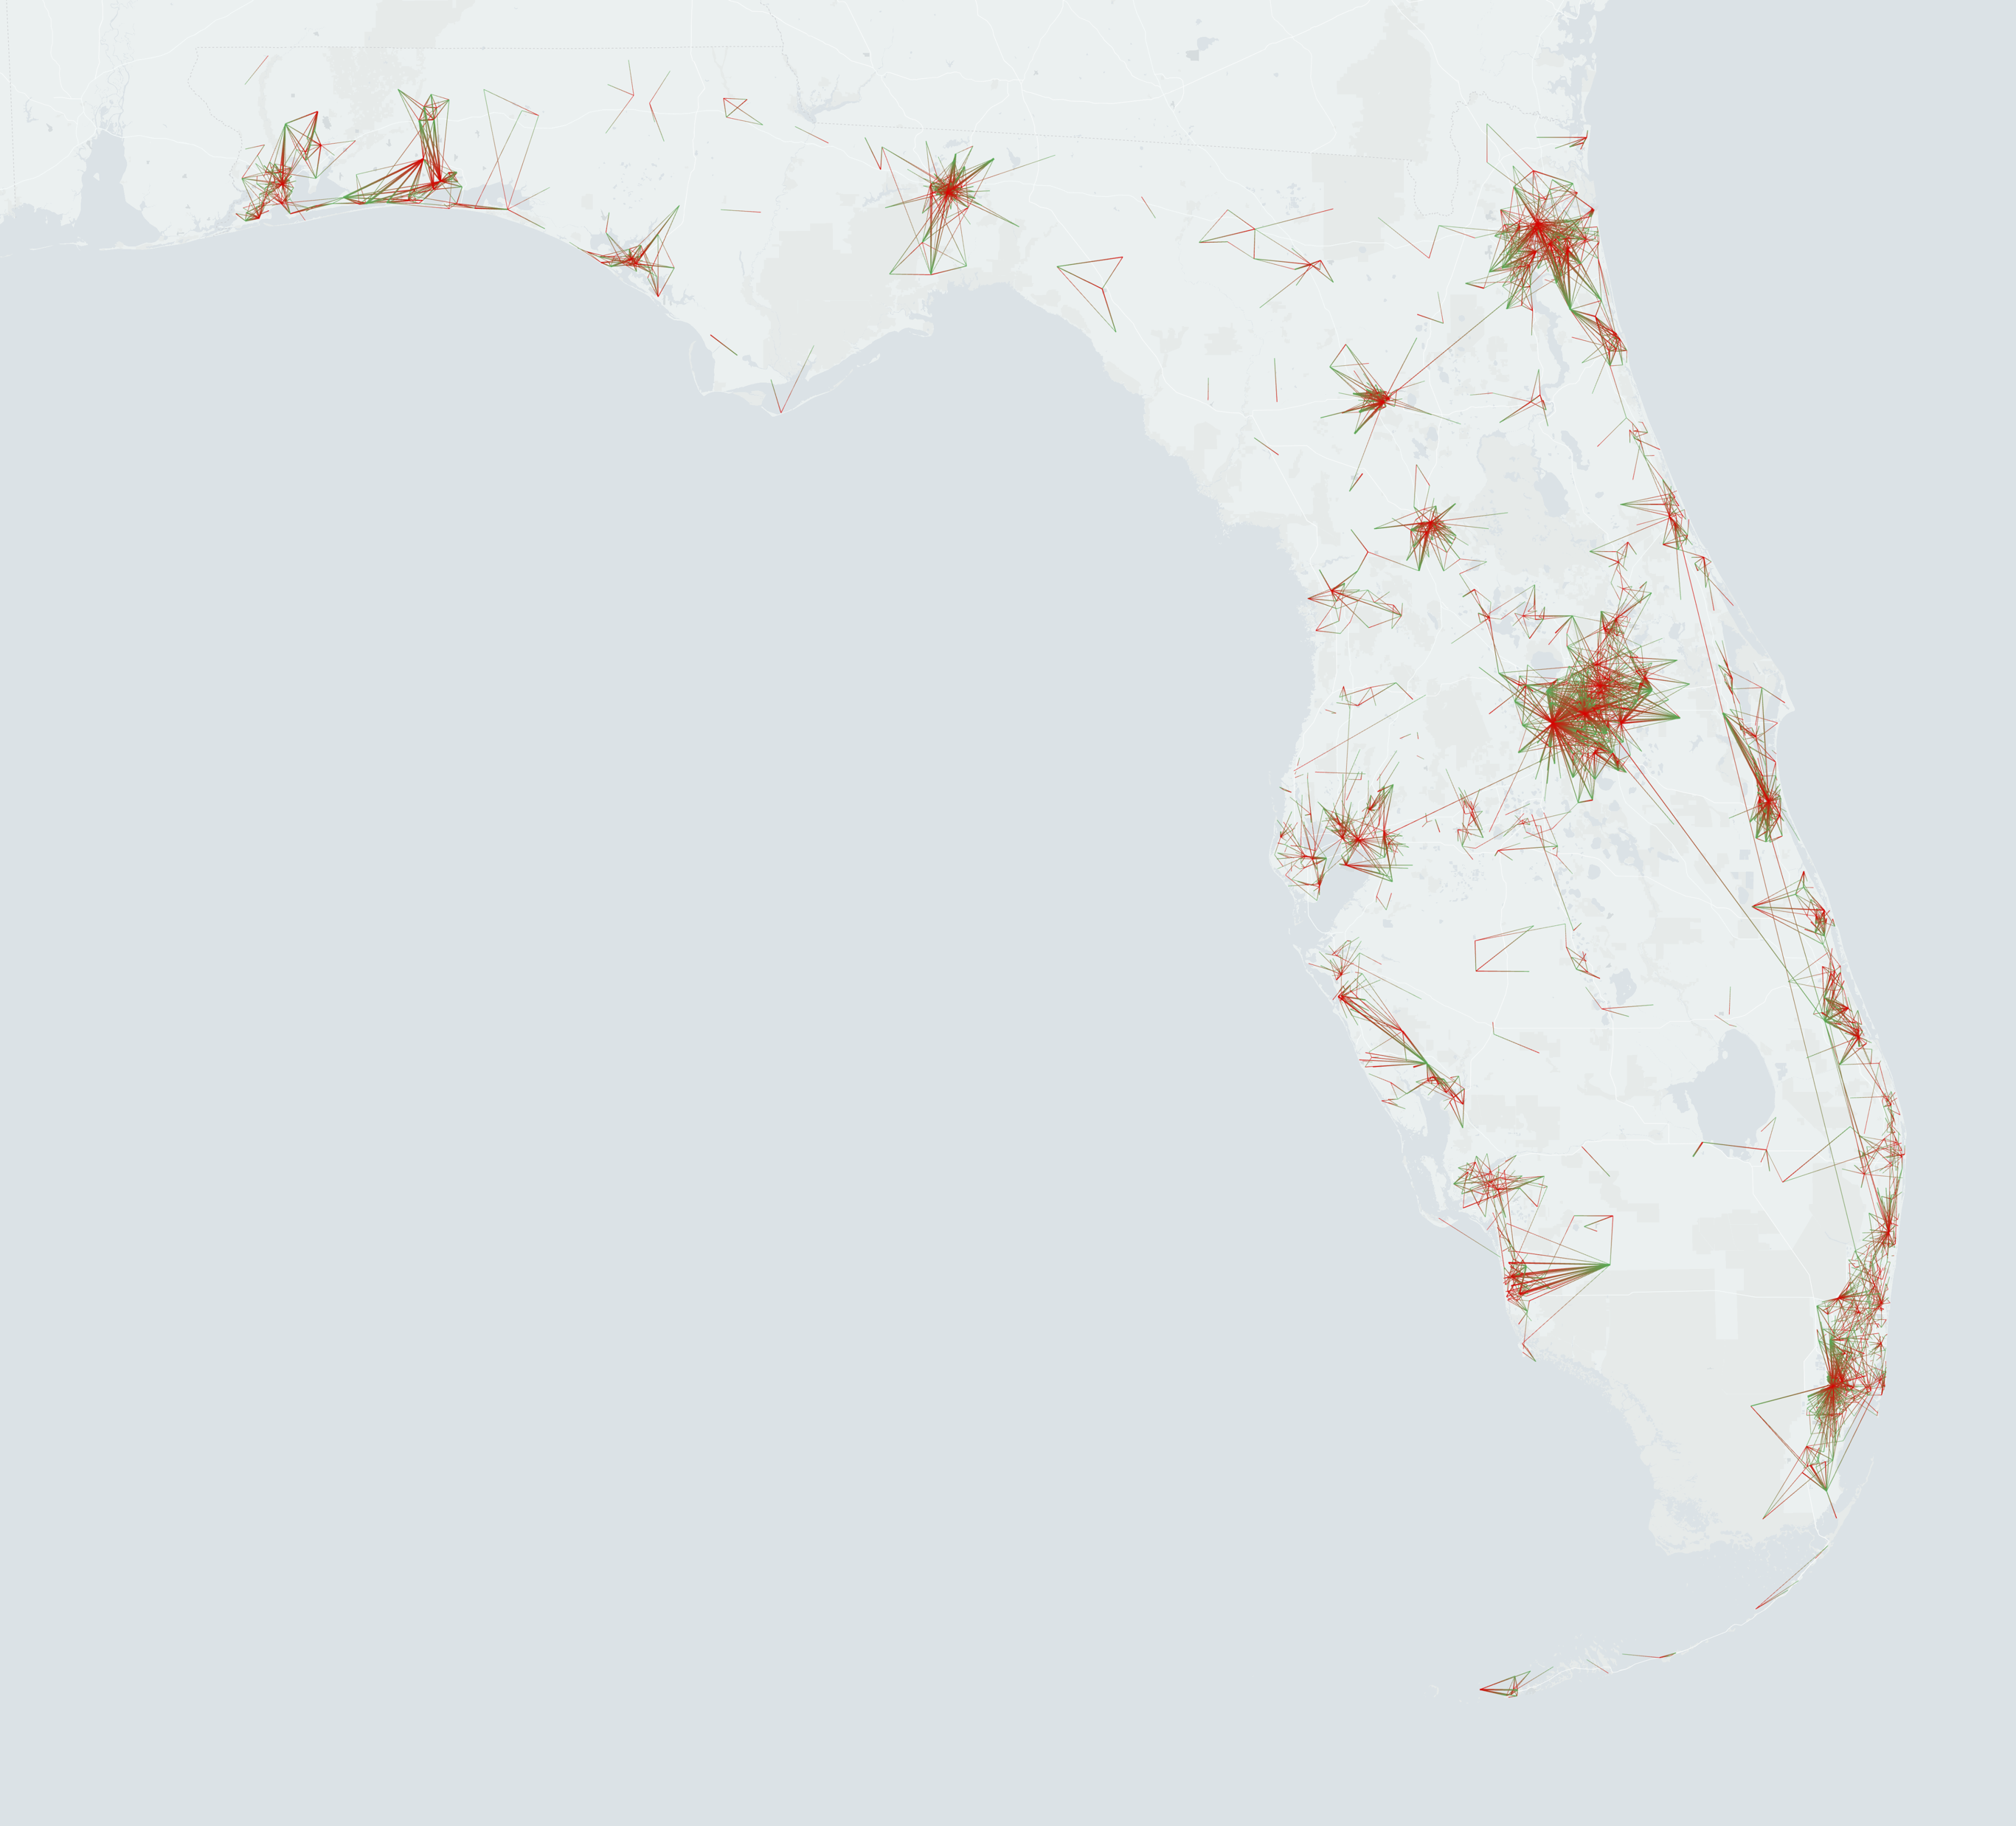
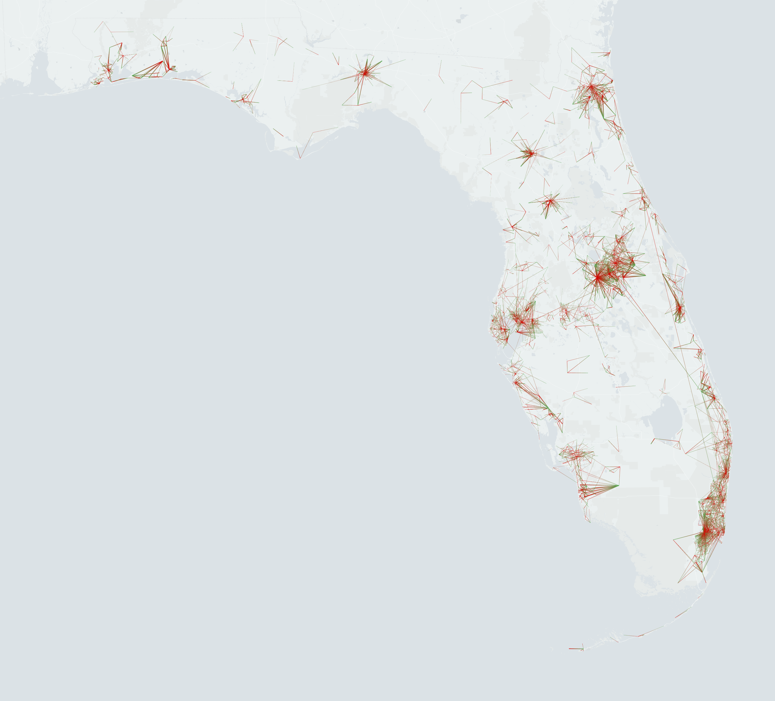
Result Comparison
GTB
Cutoff Threshold = 120
4,459 flows (edges)
2,382 census tracts (nodes)
DFB
Cutoff $α$ = 0.01
4,507 flows (edges)
3,109 census tracts (nodes)
Notes:
More tracts included in the DFB than GTB

Slide 9
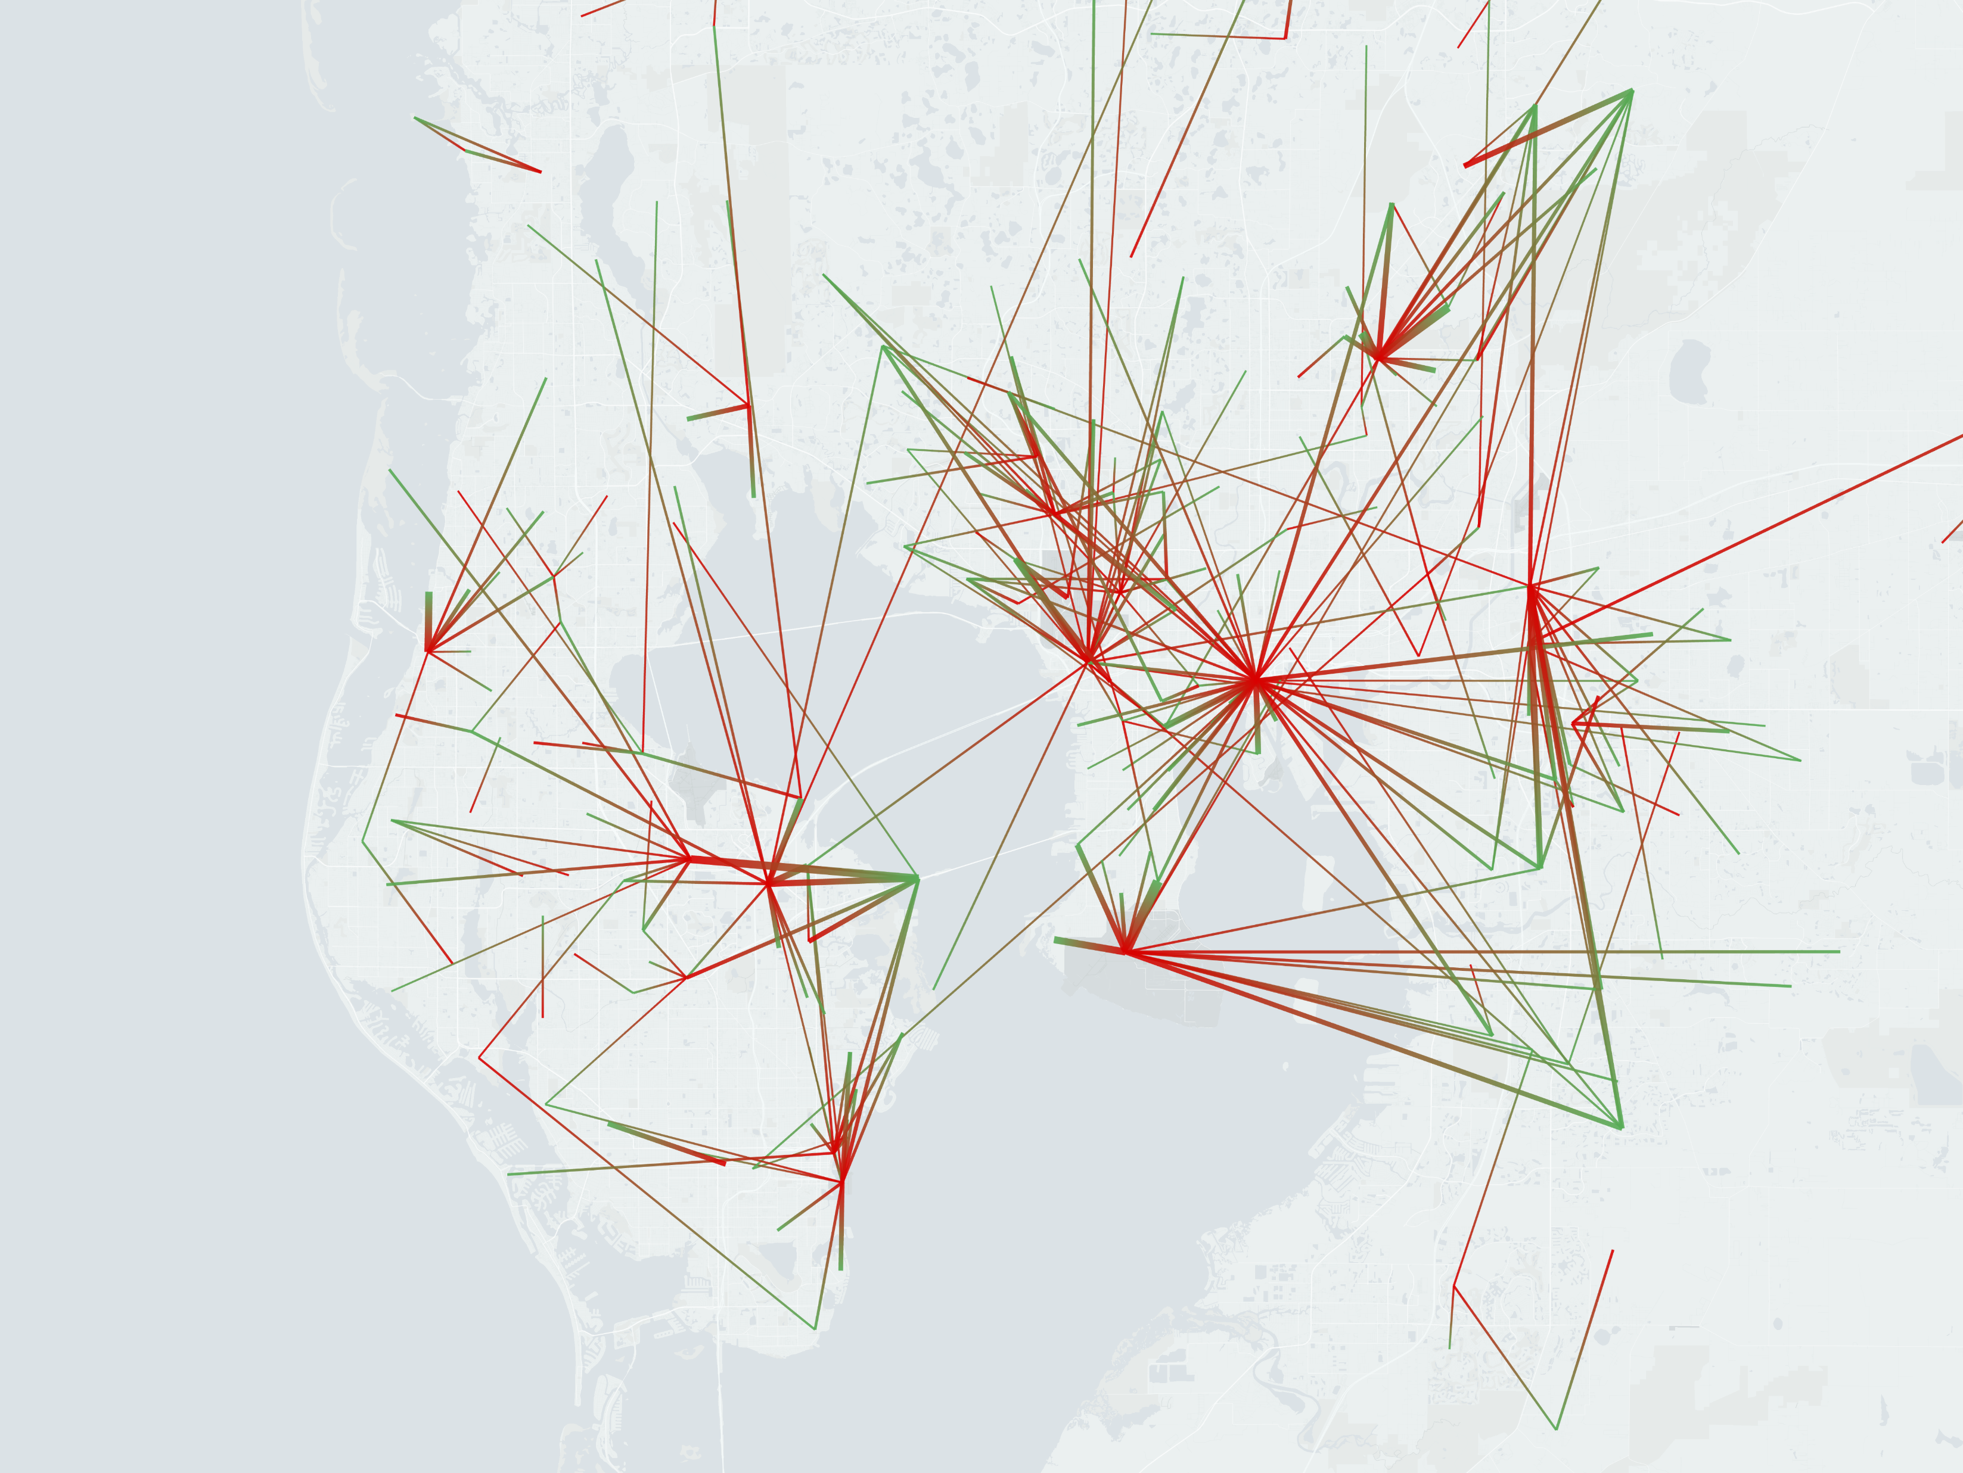
Comparison (Tampa Bay)
GTB
DFB

Slide 10
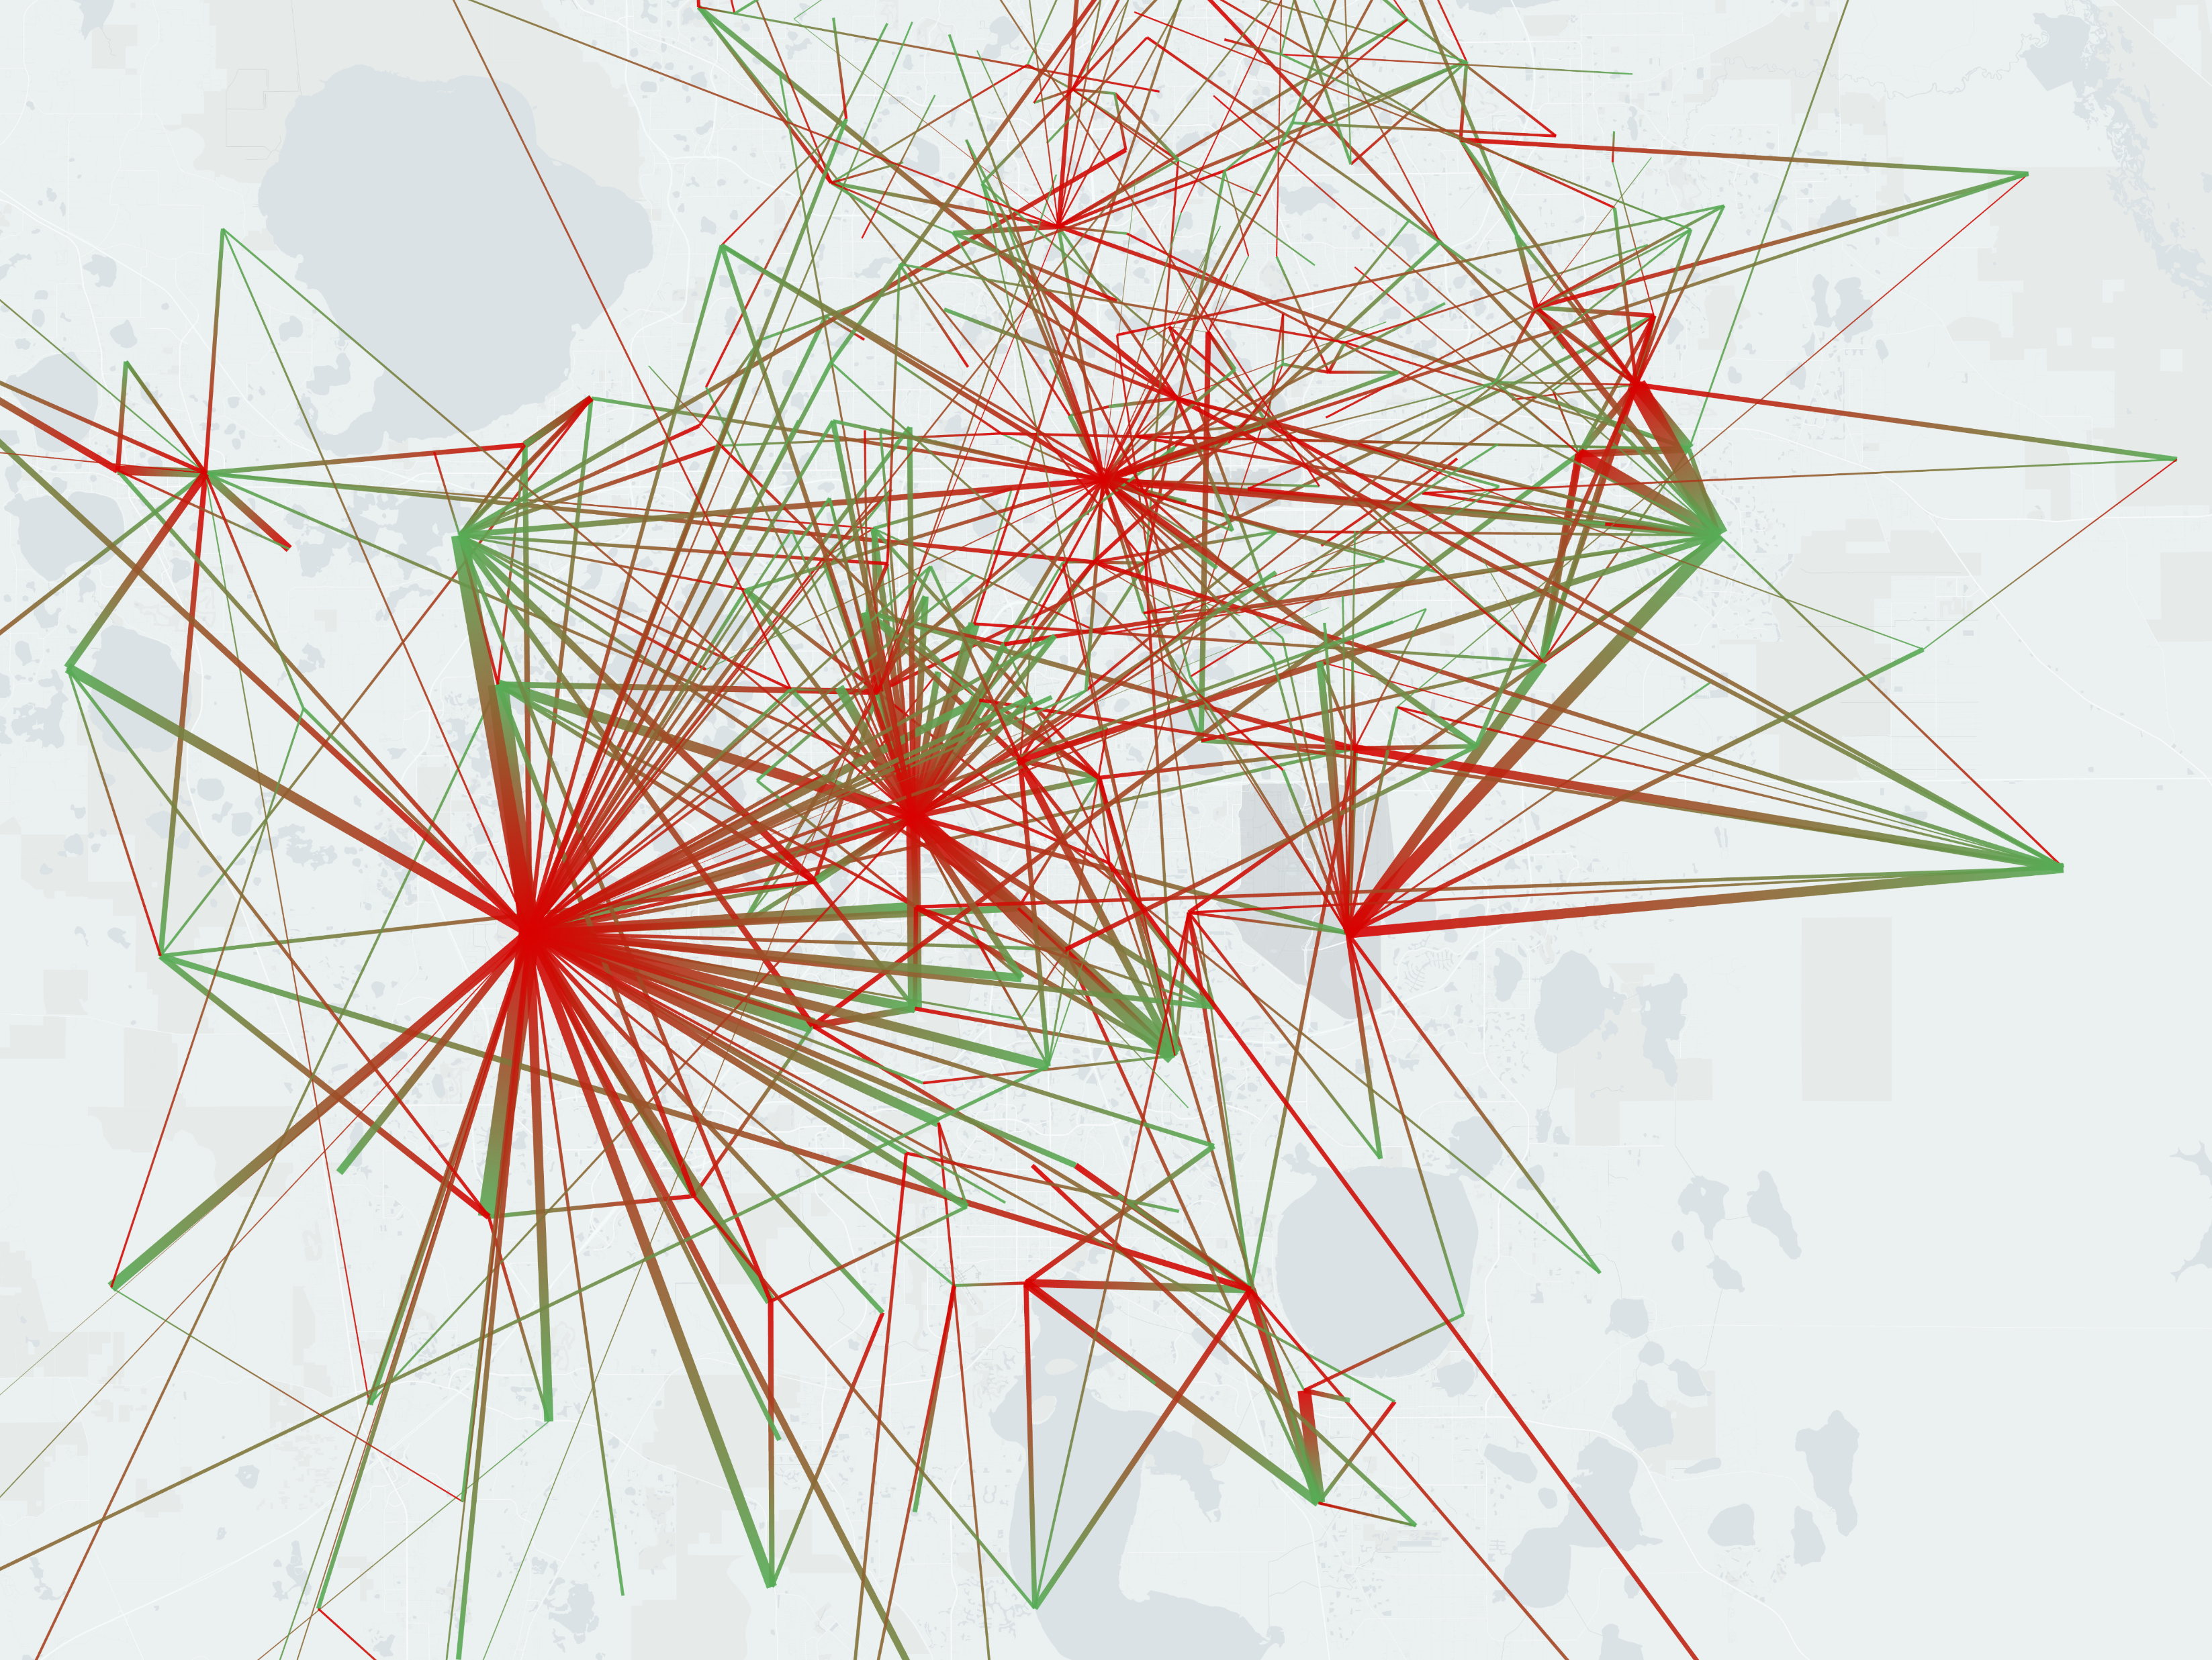
Comparison (Orlando)
GTB
DFB
Notes:
Tampa vs Orlando

Slide 11
Statistics using MSA
Calculate proportionally expected number of commuters from each MSA
Compare to the actual number of commuters in the backbone from each MSA
Get the percentage difference
Difference of the 5 largest MSAs in Florida (Origin)
MSA | DFB Difference | GTB Difference
Miami-Fort Lauderdale-Pompano Beach, FL | -21.00% | -57.16%
Tampa-St. Petersburg-Clearwater, FL | -22.04% | -64.81%
Orlando-Kissimmee-Sanford, FL | +39.71% | +56.57%
Jacksonville, FL | -5.72% | +44.77%
North Port-Sarasota-Bradenton, FL | -25.33% | -38.46%

Slide 12
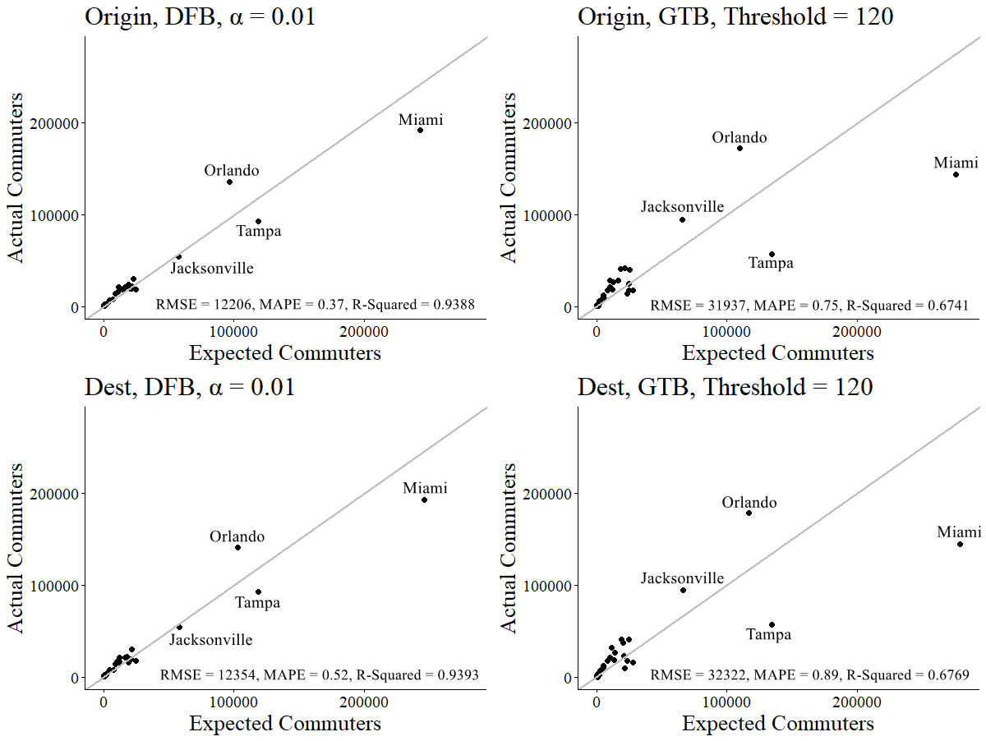
MSA Regression Analysis

Slide 13
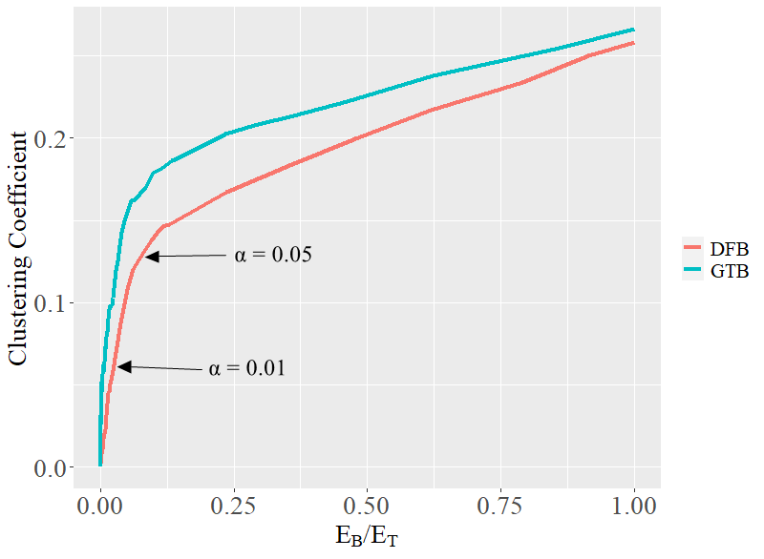
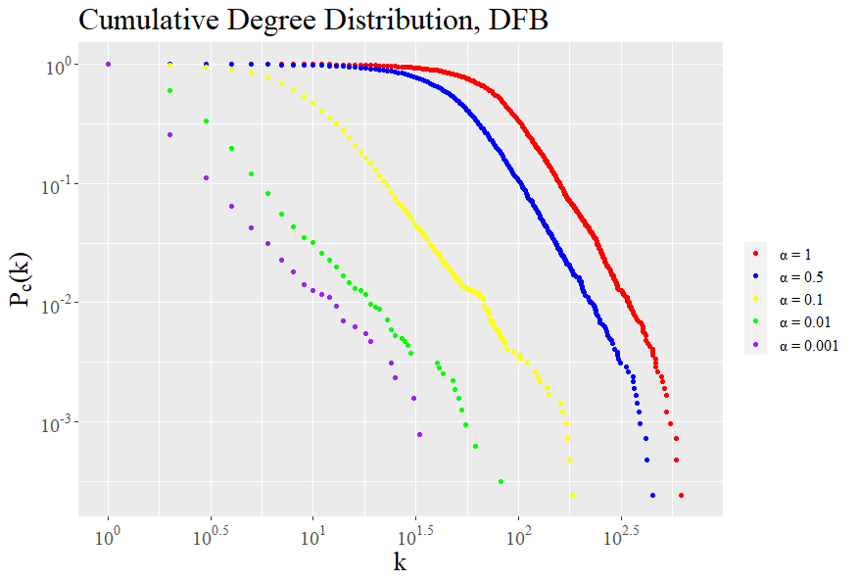
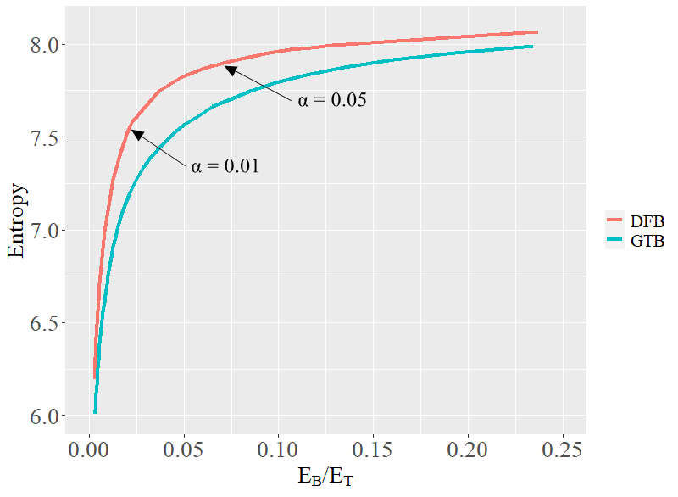

Slide 14
DFB on Road Network
Shortest Distance
ArcGIS Online

Slide 15
Conclusion
Global thresholding method punished metropolitan areas with low intensity flows and rewarded the ones with high intensity flows
Disparity filter algorithm reduced the commuting network more proportionally for visualization

Slide 16
Thanks

