Slide 1
15-Minute City Model: Sustainable Mobility, Climate Action, and Just Transition
Reem Cherif
PhD researcher
This presentation is part of a conceptual framework for a PhD thesis, Testing the 15-Minute Model: Justice, Mobility, Land use, and Finance in Dublin

Slide 2
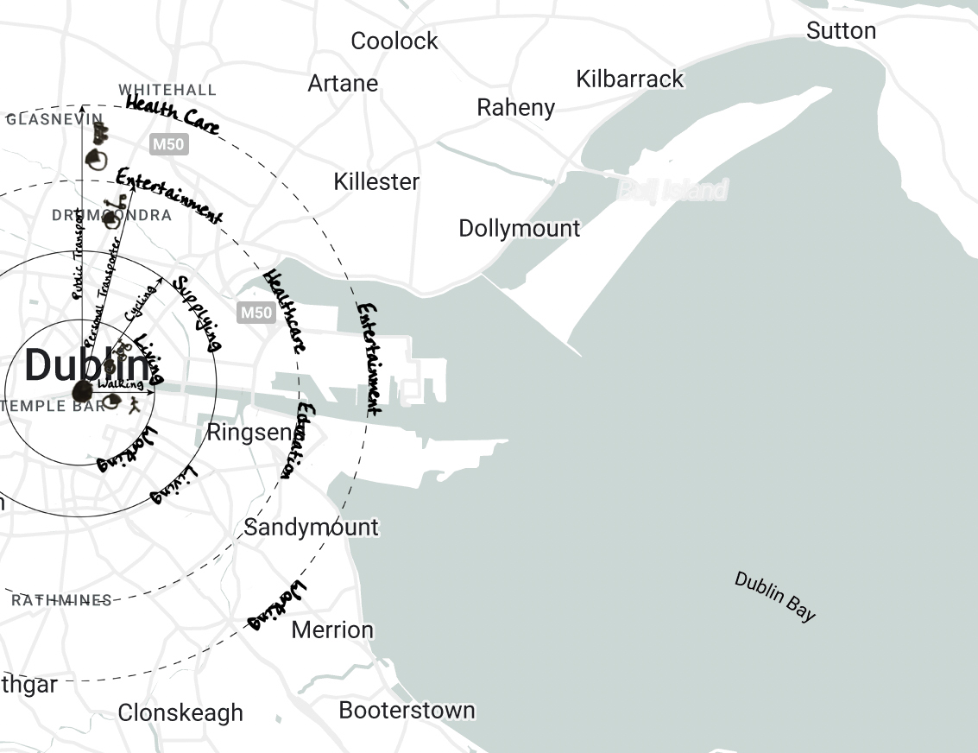
The 15-Minute City Model
What is a 15-minute city?
An urban transformation to cities that is organized around the quality of everyday life within the inhabitants’ reach in fifteen minutes covered geographical range that is primarily limited to walking and cycling but could be extended to powered transporters or public transport.
Allam, Z., Moreno, C., Chabaud, D. and Pratlong, F., 2021. Proximity-Based Planning and the “15-Minute City”: A Sustainable Model for the City of the Future. In: The Palgrave Handbook of Global Sustainability, pp. 1–20. https://doi.org/10.1007/978-3-030-38948-2_178-1.
Allam, Z., Bibri, S.E., Chabaud, D. and Moreno, C., 2022a. The ‘15-Minute City’ concept can shape a net-zero urban future. Humanities and Social Sciences Communications 9, 126. https://doi.org/10.1057/s41599-022-01145-0.
C40 Cities, 2020. How to build back better with a 15-minute city. C40 Knowledge Hub, July. https://www.c40knowledgehub.org/s/article/How-to-build-back-better-with-a-15-minute-city?language=en_US.
Moreno, C., 2016. ville du quart d'heure : pour un nouveau chrono-urbanisme. La Tribune, 5 October. https://www.latribune.fr/regions/smart-cities/la-tribune-de-carlos-moreno/la-ville-du-quart-d-heure-pour-un-nouveau-chrono-urbanisme-604358.html.

Slide 3
The 15-Minute City Model
Pillars of the 15-minute city
Diversity
Proximity
Density
Ubiquity
Mixed land uses
Social mix
Range of housing
Temporal proximity
Spatial Proximity
Connection
Dense neighborhoods
Dense utilization
Multiple functions
Affordable
Available
Common
Allam, Z., Moreno, C., Chabaud, D. and Pratlong, F., 2021. Proximity-Based Planning and the “15-Minute City”: A Sustainable Model for the City of the Future. In: The Palgrave Handbook of Global Sustainability, pp. 1–20. https://doi.org/10.1007/978-3-030-38948-2_178-1.
Chaire ETI, 2019. Ville du ¼ d’heure, Territoire de la ½ heure. In: Le Livre Blanc. Transitions urbaines etterritoriales.
Luscher, D., 2020. Introducing the 15-Minute City Project. Medium, 17 June. https://luscher.medium.com/introducing-the-15-minute-city-project-b9c0562e1725.
Moreno, C., 2020. Vie urbaine et proximité à l‘heure du COVID-19. Éditions de l’Observatoire, Paris, France.

Slide 4
Just Transition
Justice framework
z
Climate action
Post-carbon societies
Continuous process of change, a transition
Fair and equitable process
Axon, S. and Morrissey, J., 2020. Just energy transitions? Social inequities, vulnerabilities and unintended consequences. Buildings and Cities, 1(1), pp. 393-411. DOI: http://doi.org/10.5334/bc.14.
Environmental Defence, 2022. The Canadian investor’s guide to investing in the just transition. Environmental Defence, 23 March. https://environmentaldefence.ca/2022/03/23/the-canadian-investors-guide-to-investing-in-the-just-transition/.
Heffron, R.J., 2021. What is the “Just Transition”?. In: Achieving a Just Transition to a Low-Carbon Economy. Palgrave Macmillan, Cham. https://doi.org/10.1007/978-3-030-89460-3_2.
Hughes, S. and Hoffmann, M., 2020. Just urban transitions: Toward a research agenda. Wiley Interdisciplinary Reviews: Climate Change, 11(3). https://doi.org/10.1002/wcc.640.

Slide 5
Sustainable Mobility
Environmental
Efficiency
Initiating
Socio-economic
Technological
Reducing
Gallo, M. and Marinelli, M., 2020. Sustainable Mobility: A Review of Possible Actions and Policies. Sustainability, 12(18). https://doi.org/10.3390/su12187499.
Gota, S., Huizenga, C., Peet, K., Medimorec, N., and Bakker, S., 2019. Decarbonising transport to achieve Paris Agreement targets. Energy Efficiency, 12(2), pp. 363–386. https://doi.org/10.1007/s12053-018-9671-3.
Inturri, G., Ignaccolo, M., LePira, M., Caprì, S., and Giuffrida, N., 2017. Influence of accessibility, land use and transport policies on the transport energy dependence of a city. Transportation Research Procedia, 25, pp. 3273–3285. https://doi.org/10.1016/j.trpro.2017.05.165.
Santos, G., 2018. Sustainability and Shared Mobility Models. Sustainability, 10(9). https://doi.org/10.3390/su10093194.

Slide 6
15-minute City, Sustainable Mobility, and Just Transition
Distributional justice of facilities
Initiating
Reducing
Post-carbon societies

Slide 7
How to ensure the transition is just? Questioning the Concept
A ‘humane city’ ?
Different travel experiences (gender, age, disability, ..)
Concerns about inequalities and exclusion
Disadvantaged areas?
Poor-quality amenities
Can everyone work remotely?
Affordability and housing situation
Ratti, C. and Florida, R., 2021. The 15-minute city meets human needs but leaves desires wanting. Here’s why. World Economic Forum, 11 November. https://www.weforum.org/agenda/2021/11/15minute-city-falls-short/.
Florida, R., Moreno, C., Khan, J. S., and Murphy, P., 2020. The Rise of the 15- Minute Neighbourhood [Webinar]. The Aspen Institute, 20 November. https://www.youtube.com/watch?v=UzsemYTXYIQ.
Gehl, J., Hopkins, R., Chu, H., Agyeman, J., and Bozikovic, A., 2020. The ‘15- minute city’: why shouldn’t all you need be near where you live? [Webinar]. Tortoise, 19 November. https://www.youtube.com/watch?v=Qn8TMW18QC8&list=PLnkhEwLU1gyZvaKX8b1D-0iFl3CGC6WQ&index=10.
Sassen, S., Moreno, C., and Bria, F., 2021. The city of the future visions, projects and Utopia [Webinar]. ISPI, 18 March. https://www.youtube.com/watch?v=SC7T_bGTdwQ.

Slide 8
How to ensure the transition is just? Questioning the Concept
The current geographies of work and housing?
Utilization of land price differences
Concerns about industry agglomeration, housing affordability, and gentrification
Gentrification?
The loss of affordable living in local areas
Swinney, J., 2021. Will Covid-19 make the idea of the 15 minute city a reality? [Podcast]. Centre For Cities, 17 February. https://www.centreforcities.org/blog/will-covid-19-make-the-idea-of-the-15-minute-city-a-reality/.
Peverini, M. and Chiaro, G., 2020. Questioni di Scala: L’illusione della Citta dei 15 minuti. Arcipelago Milano, 26 November. https://www.arcipelagomilano.org/archives/57231.
Descant, S., 2021. Equitable Urban Planning May Mean Ditching the 15-Minute City. Government Technology, 9 March. https://www.govtech.com/fs/equitable-urban-planning-maymean-ditching-the-15-minute-city.html.

Slide 9
How to ensure the transition is just? Questioning the Concept
Connectivity?
Limiting the need to travel to different areas
Concerns about city and land use planning, and governance
The different contexts of cities, and neighbourhoods?
Culture
Urban fabric
Delaleu, A., 2020. La Ville du quart d’heure : utopie? fantasme? écran de fumée?. Chroniques d’architecture, 25 August. https://chroniques-architecture.com/la-ville-du-quart-dheure-ecran-de-fumee/.
Yeung, P., 2021. How “15-minute cities” will change the way we socialise. BBC, 4 January. https://www.bbc.com/worklife/article/20201214-how-15-minute-cities-will-change-the-way-we-socialise.
Dunning, R., Calafiore, A., and Nurse, A., 2021. 20-minute neighbourhood or 15-minute city? Town and Country Planning. https://livrepository.liverpool.ac.uk/3127722/.
Descant, S., 2021. Equitable Urban Planning May Mean Ditching the 15-Minute City. Government Technology, 9 March. https://www.govtech.com/fs/equitable-urban-planning-maymean-ditching-the-15-minute-city.html.
Steuteville, R., 2021. The 15-minute neighborhood gets its 15 minutes of fame. Congress for New Urbanism, 25 January. https://www.cnu.org/publicsquare/2021/01/25/15- minute-neighborhood-gets-its-15-minutes-fame.

Slide 10
How to ensure the transition is just?
Main focus: How can we deliver a more just distribution of facilities?
Social engagement
Marginalized and transport-disadvantaged areas
Local needs and travel differences
Common goods
Open public spaces
Public interests
Local - regional balance
Alleviate consequences on affordable housing
Preventing risk of displacement
15-minute city for all
Inclusive and Accessible

Slide 11
cherifr@tcd.ie

